Slide 1
CS4225/CS5425 Big Data Systems for Data Science
Tutorial 4 Answers
Desmond Lau
School of Computing
National University of Singapore
dlau@nus.edu.sg

Slide 2
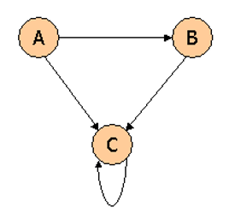
Question 1
Consider three Web pages with the following links:
Suppose we compute PageRank with a β of 0.7 (note: we assume that the sum of the PageRanks of the three pages must be 1, to handle the problem that otherwise any multiple of a solution will also be a solution). Compute the PageRanks a, b, and c of the three pages A, B, and C, respectively.

Slide 3
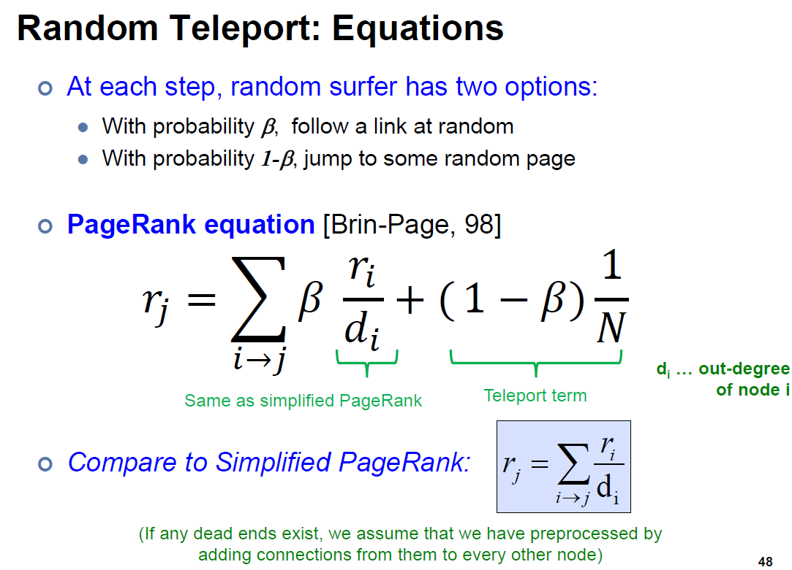
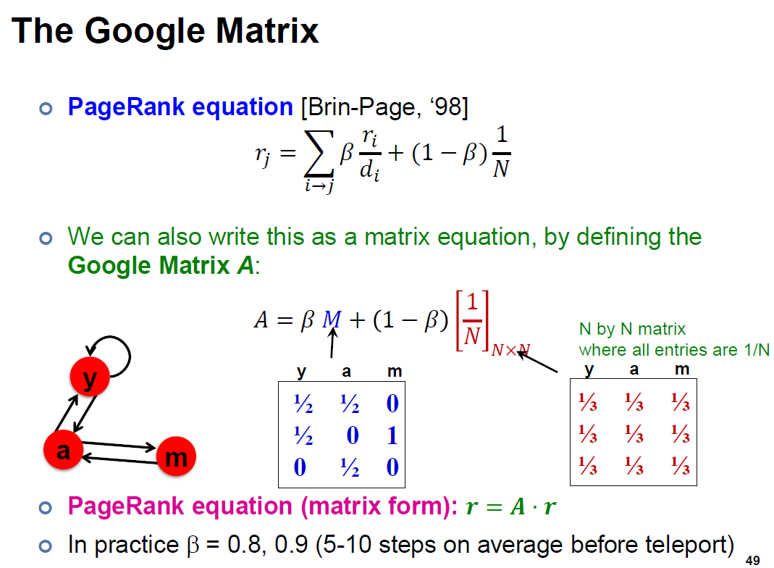
Lecture 10 Slide 48
Lecture 10 Slide 49

Slide 4
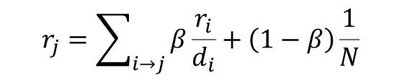

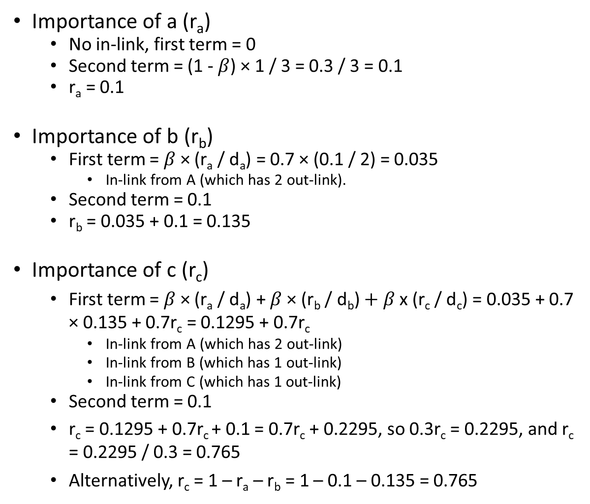
Importance of a (r_{a})
  No in-link, first term = 0
  Second term = (1 - $β$) × 1 / 3 = 0.3 / 3 = 0.1
  r_{a} = 0.1
Importance of b (r_{b})
  First term = $β$ × (r_{a} / d_{a}) = 0.7 × (0.1 / 2) = 0.035
    In-link from A (which has 2 out-link).
  Second term = 0.1
  r_{b} = 0.035 + 0.1 = 0.135
Importance of c (r_{c})
  First term = $β$ × (r_{a} / d_{a}) + $β$ × (r_{b} / d_{b}) $+ β$ x (r_{c} / d_{c}) = 0.035 + 0.7 × 0.135 + 0.7r_{c} = 0.1295 + 0.7r_{c}
    In-link from A (which has 2 out-link)
    In-link from B (which has 1 out-link)
    In-link from C (which has 1 out-link)
  Second term = 0.1
  r_{c} = 0.1295 + 0.7r_{c} + 0.1 = 0.7r_{c} + 0.2295, so 0.3r_{c} = 0.2295, and r_{c} = 0.2295 / 0.3 = 0.765
  Alternatively, r_{c} = 1 – r_{a} – r_{b} = 1 – 0.1 – 0.135 = 0.765
$$r_{j}=\sum_{i→j}{β\frac{r_{i}}{d_{i}}}+\left(1−β\right)\frac{1}{N}$$
$β$ = 0.7

Slide 5
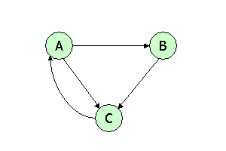
Question 2
Consider three Web pages with the following links:
Suppose we compute PageRank with a β of 0.85. Write the equations for the PageRanks a, b and c of the three pages A, B and C, respectively.

Slide 6
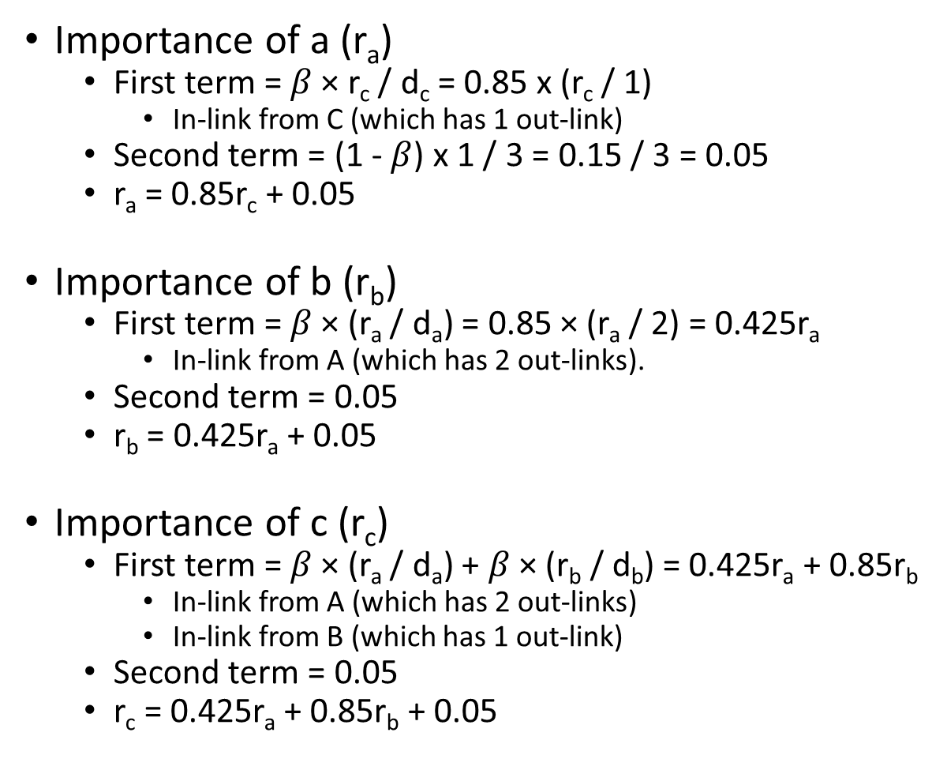

Importance of a (r_{a})
  First term = $β$ × r_{c} / d_{c} = 0.85 x (r_{c} / 1)
    In-link from C (which has 1 out-link)
  Second term = (1 - $β$) x 1 / 3 = 0.15 / 3 = 0.05
  r_{a} = 0.85r_{c} + 0.05
Importance of b (r_{b})
  First term = $β$ × (r_{a} / d_{a}) = 0.85 × (r_{a} / 2) = 0.425r_{a}
    In-link from A (which has 2 out-links).
  Second term = 0.05
  r_{b} = 0.425r_{a} + 0.05
Importance of c (r_{c})
  First term = $β$ × (r_{a} / d_{a}) + $β$ × (r_{b} / d_{b}) = 0.425r_{a} + 0.85r_{b}
    In-link from A (which has 2 out-links)
    In-link from B (which has 1 out-link)
  Second term = 0.05
  r_{c} = 0.425r_{a} + 0.85r_{b} + 0.05
$$r_{j}=\sum_{i→j}{β\frac{r_{i}}{d_{i}}}+\left(1−β\right)\frac{1}{N}$$
$β$ = 0.85

Slide 7
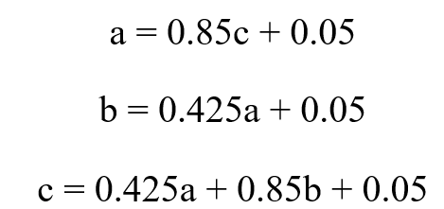
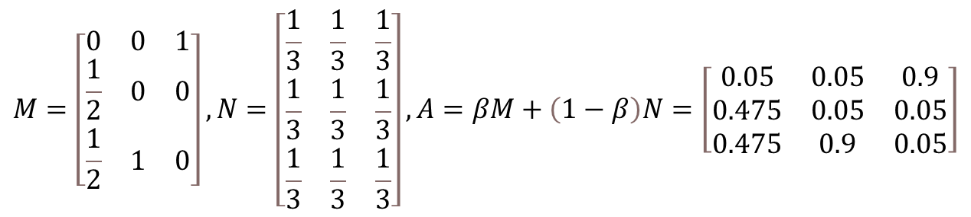
Also note that it is also fine to use the matrix form of the PageRank equations:
$$M=\left[\begin{matrix}0 & 0 & 1 \\ \frac{1}{2} & 0 & 0 \\ \frac{1}{2} & 1 & 0\end{matrix}\right], N=\left[\begin{matrix}\frac{1}{3} & \frac{1}{3} & \frac{1}{3} \\ \frac{1}{3} & \frac{1}{3} & \frac{1}{3} \\ \frac{1}{3} & \frac{1}{3} & \frac{1}{3}\end{matrix}\right], A=βM+\left(1−β\right)N=\left[\begin{matrix}0.05 & 0.05 & 0.9 \\ 0.475 & 0.05 & 0.05 \\ 0.475 & 0.9 & 0.05\end{matrix}\right]$$
The PageRank equation is then r=Ar, where r is PageRank, which could also be written as:
a=0.05a+0.05b+0.9c
b=0.475a+0.05b+0.05c OR
c=0.475a+0.9b+0.05c
Note that although these are equivalent solutions, we recommend you simplify to the latter presentation in the exam, for ease of marking.

Slide 8
Also note that it is also fine to use the matrix form of the PageRank equations:
$$M=\left[\begin{matrix}0 & 0 & 1 \\ \frac{1}{2} & 0 & 0 \\ \frac{1}{2} & 1 & 0\end{matrix}\right], N=\left[\begin{matrix}\frac{1}{3} & \frac{1}{3} & \frac{1}{3} \\ \frac{1}{3} & \frac{1}{3} & \frac{1}{3} \\ \frac{1}{3} & \frac{1}{3} & \frac{1}{3}\end{matrix}\right], A=βM+\left(1−β\right)N=\left[\begin{matrix}0.05 & 0.05 & 0.9 \\ 0.475 & 0.05 & 0.05 \\ 0.475 & 0.9 & 0.05\end{matrix}\right]$$
The PageRank equation is then r=Ar, where r is PageRank, which could also be written as:

Slide 9
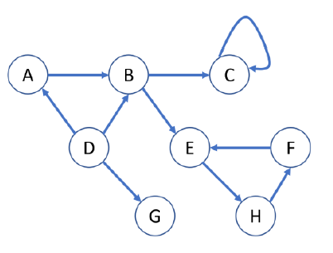
Question 3
Given the following graph:
How many dead ends are there in the graph? For each dead end (if any), please indicate the set of vertices forming the dead end.
How many spider traps are there in the graph? For each spider trap (if any), please indicate the set of vertices forming the spider trap.

Slide 10
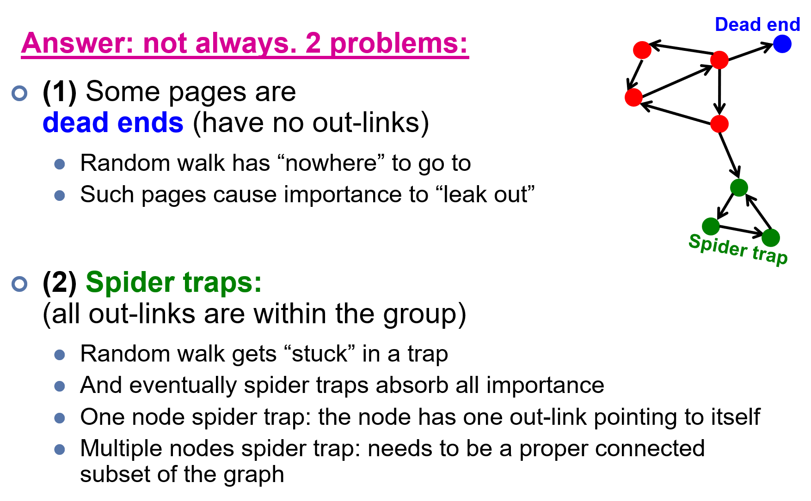
Answer 3
Lecture 10 Slide 36

Slide 11
Answer 3
Dead ends:
{G}
Spider traps:
{C},
{E, F, H},
{B, C, E, F, H},
{A, B, C, E, F, H}

Slide 12
Question 4
True/False: In Topic-specific PageRank, random walker will teleport to any page with equal probability.
Answer 4
False. Random walker will only teleport to a topic-specific set of “relevant” pages.

Slide 13
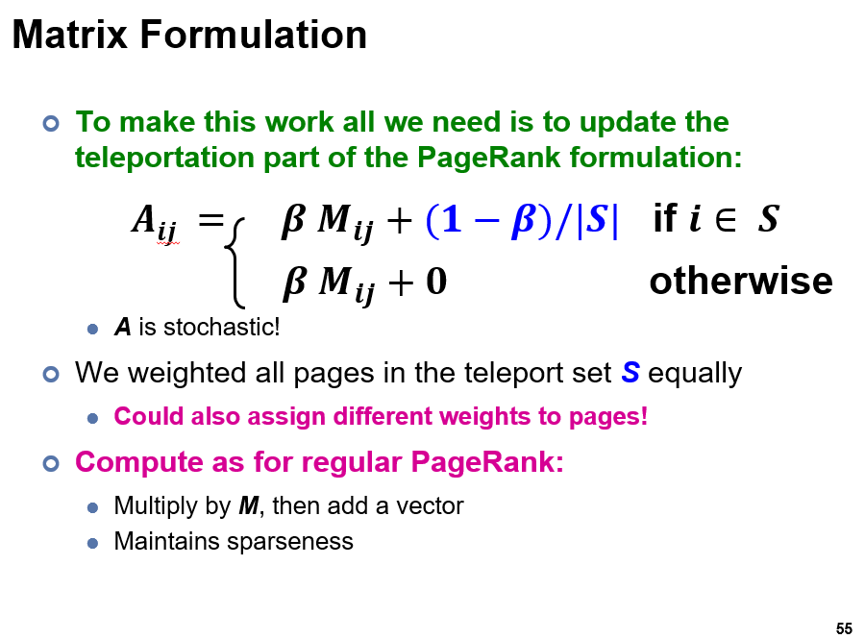
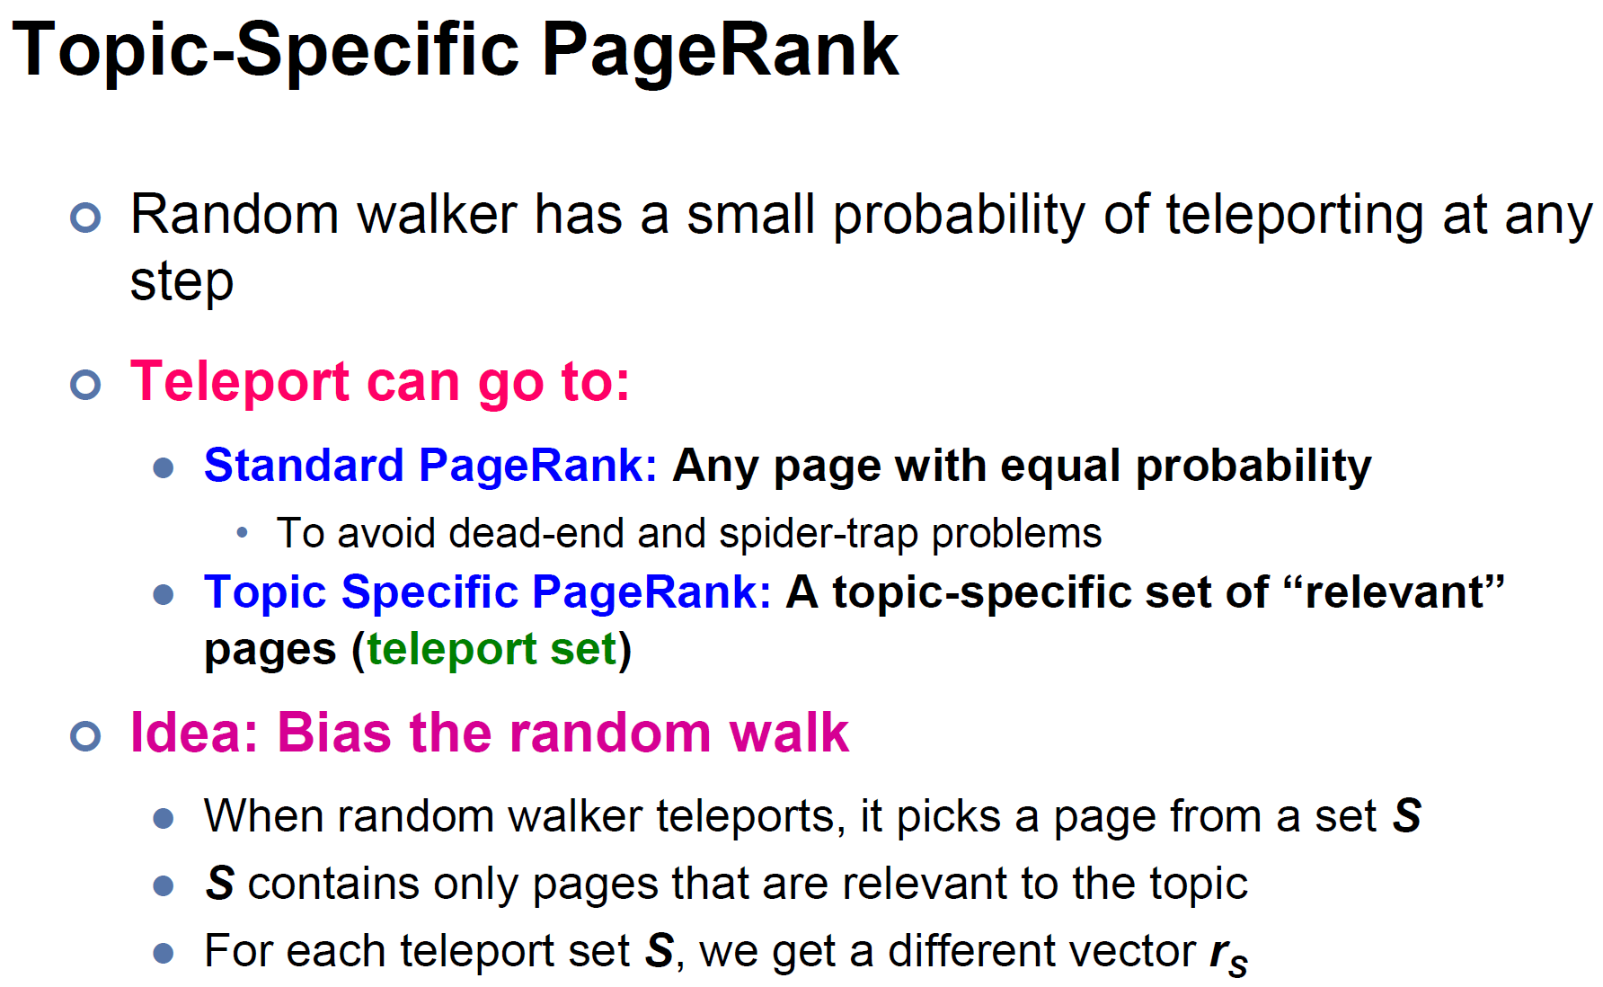
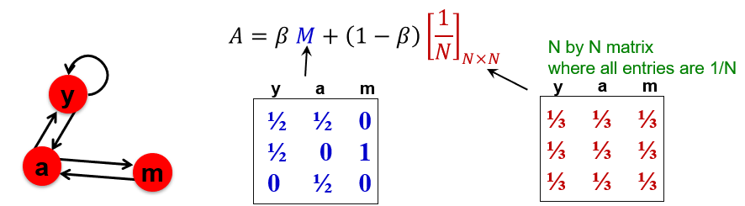
Lecture 10 Slide 55
Lecture 10 Slide 54
Lecture 10 Slide 49

Slide 14
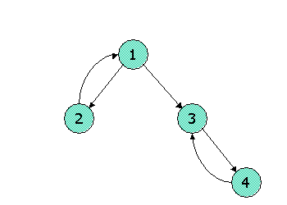
Question 5
Consider the following link topology.
Write down the Topic-Specific PageRank equations for the following link topology. Assume that pages selected for the teleport set are nodes 1 and 2 (where teleports go to either node with equal probability). Assume further that the teleport probability, (1 - β), is 0.3.

Slide 15

Answer 5
S = {1,2}, β = 0.7
Recall the topic specific pagerank (TSPR) equations:
Basically, the only difference here (compared to the non-topic specific case in the last 2 questions), is that the teleport terms are only distributed among the nodes in the teleport S, instead of being distributed over all nodes. Let r₁, r₂, r₃, r₄ denote the importance of the 4 nodes.

Slide 16
Answer 5
S = {1,2}, β = 0.7
r₁ = 0.7 (r₂) + (1 – 0.7) / 2
r₂ = 0.7 (r₁ / 2) + (1 – 0.7) / 2
r₃ = 0.7 (r₁ / 2 + r₄) + 0
r₄ = 0.7 (r₃) + 0
r₁ = 0.7r₂ + 0.15
r₂ = 0.35r₁ + 0.15
r₃ = 0.35r₁ + 0.7r₄
r₄ = 0.7r₃

Slide 17
Question 6
Show pseudocode for the compute() function for the PageRank with teleport (β = 0.85) over vertices algorithm in Pregel / Giraph. Set the initial PageRank value as 1/N (N is the number of vertices), Run 30 iterations and then stop. You can (if you choose) use the functions: getValue(), setValue(), getNumVertices(), getSuperStep(), getOutEdgeIterator().

Slide 18
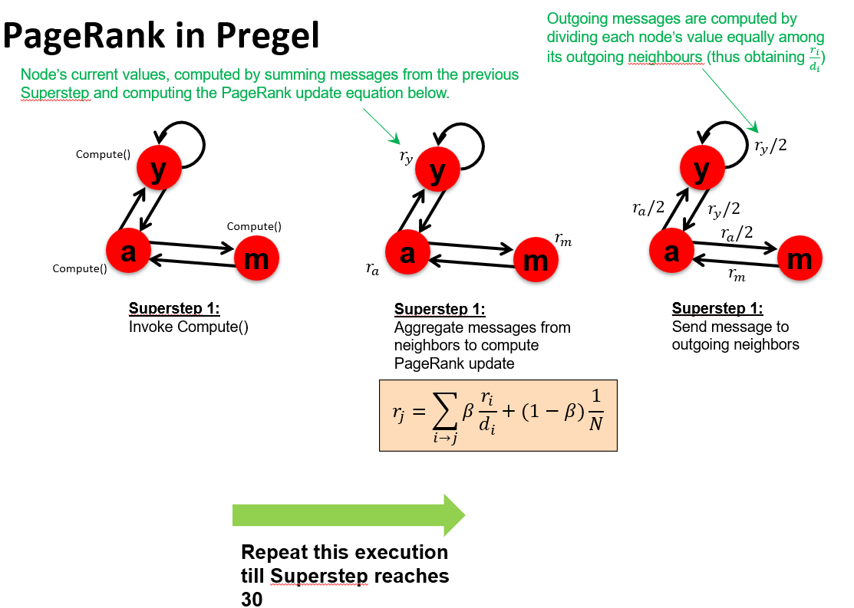
Lecture 10 Slide 68

Slide 19
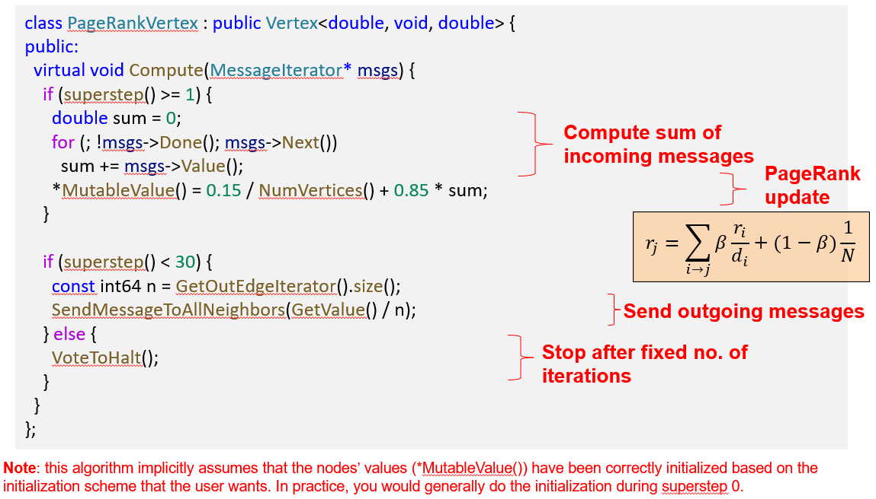
Lecture 10 Slide 69

Slide 20
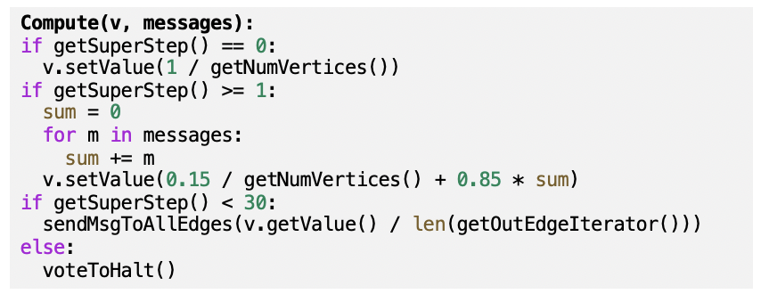
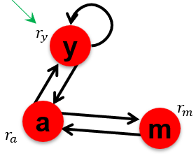
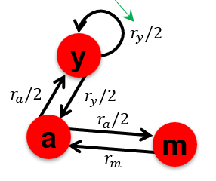
Superstep 0: initialize all vertex values to 1/N.
Superstep 1 onwards: aggregate messages from neighbors and compute PageRank update.
Supersteps under 30: send message to neighbors.
Writing pseudo code is fine; no worries about the syntax. E.g. len(x) or x.size() or “size of x” are all fine.

